Slide 1

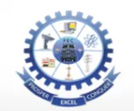
PAAVAI ENGINEERING COLLEGE (AUTONOMOUS) SMART CONTROL OF COMPUTERS WITH HAND GESTURES AND VOICE
Batch No: 7
Guided by
Dr. G.MADASAMY RAJA, M.E., Ph.D.,
PROFESSOR
Information Technology
Paavai Engineering College,Namakkal.
By
A.ELAVARASAN (20202018)
V.JAYA KRISHNAN (20202023)
A.NAVEEN KUMAR(20202032

Slide 2
SMART CONTROL OF COMPUTERS WITH HAND GESTURES AND VOICE
By
A.ELAVARASAN (20202018)
V.JAYA KRISHNAN (20202023)
A.NAVEEN KUMAR(20202032

Slide 3
Abstract
Human interaction using the hand movements probally like the wireless with the hardware component.
The movement’s of the hand are used to feed the input the system usign the camera to get the input for the interaction.
Using the different learning method the data operation predefined.
Hand sign are predefined to perform the particalur to be performed.
The input are feed through the Camera and mic over voice.
The hand gestures and captured the processed using the CNN and its used to classify the fingers of the hand.

Slide 4
Objective of the Project
Human interaction using hand gesutres.
This project makes computer to interact using the hand gestures(likely virtual mouse) and voice asstiant.
It is used to basic operation of mouse without the involvement of mouse.

Slide 5
Proposed system
Proposed system uses camera to capture the hand and process.CNN are used to classify the fingers and voice to get clear and reduce the nosie of the data.
CNN are mostly used to cutoff the nosiy data before the execution of program.
The defined operation are performed using the capture image and processed based on the conditon.

Slide 6
Advantage of Proposed System
• High accuracy
• Fast response
• Easy to track the moments
• User friendly
• Easy to detect the finger posture

Slide 7
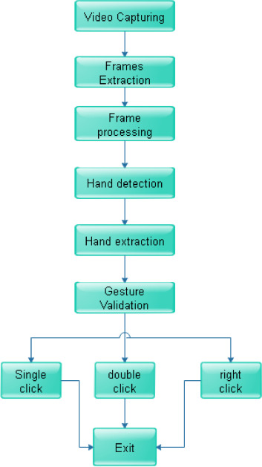
Block Diagram

Slide 8
Methodology:
Module 1: Hand image acquisition
Module 2: Plot points using hand skeleton
Module 3:Gesture recognition
Module 4:Voice recognition
Module 5: Track the moments

Slide 9
Module 1: Hand image acquisition
The realm of human-computer interaction is increasingly embracing gesture-based systems, paving the way for various application scenarios. The efficacy of gesture recognition solely based on the 16 extracted features through image processing still poses limitations.
Module 2: Plot points using hand skeleton
The Hand Landmarked uses a model bundle with two packaged models: a palm detection model and a hand landmarks detection model. The model was trained on approximately 30K realworld images. The hand landmarker model bundle contains a palm detection model and a hand landmarks detection model

Slide 10
Module 3 Gesture Recognition
The Gesture Recognizer task is an advanced tool that empowers users to effortlessly identify and interpret hand gestures in real time. It not only offers real-time recognition of hand gestures but also supplies detailed results concerning the recognized gestures and hand landmarks.
Module 4:Voice recognition
Speech recognition technology, a critical component of artificial intelligence (AI) systems, allows machines to simulate human behavior. The realm of AI, Natural Language Processing (NLP) plays a fundamental role in transforming human language data into a format that machines can comprehend.

Slide 11
Module 5: Track the moments
Pointing with the gesture is accomplished by moving the cursor until the pointer is positioned over a desired area or object on the screen. This pointing action is fundamental in interacting with digital interfaces as it allows users to select, click on, or interact with various elements displayed on the screen.

Slide 12
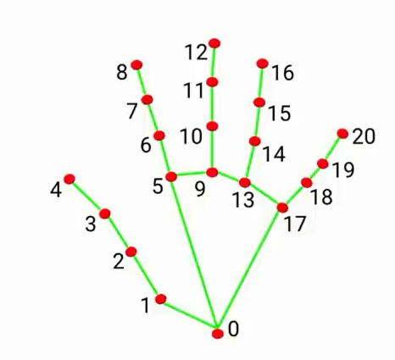
Gesture Recognition
The inputs are taken through the camera.
The images and detect the motion of the hand for their better accurancy.
The plot points are available in open platform like google.github,etc.
The points are used to vary for each moments.

Slide 13
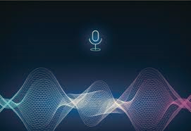
Voice recongiton
Voice recongition are used to perorm different operation like search engine ,basic common and system operation like. open,closing,shutdown,etc.
Search engine use wikipedia to get like “wh” question like
who is the 11th presdient of india?.
It act like an google assitiant in latop.

Slide 14
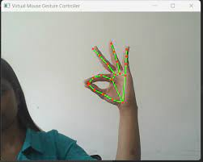
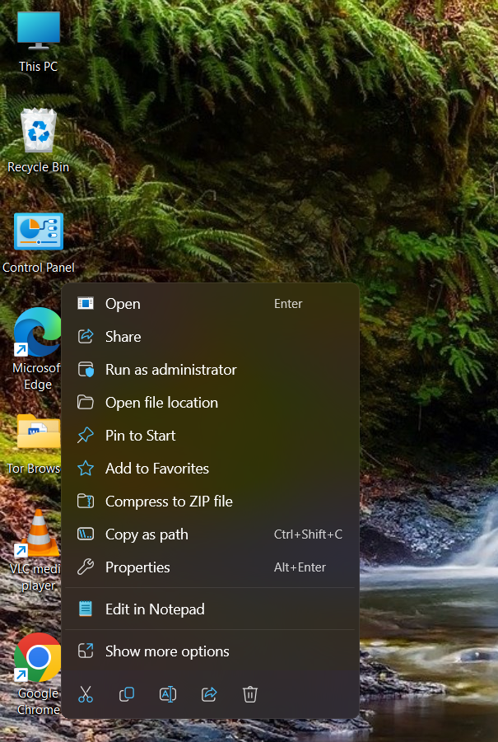
Output
input output

Slide 15
References
Abadi, M., et al. (2016). TensorFlow: A system for large-scale machine learning. In the 12th USENIX Symposium on Operating Systems Design and Implementation (OSDI 16)
Simonyan, K., & Zisserman, A. (2014). Two-stream convolutional networks for action recognition in videos. In Advances in neural information processing systems.
Nagashree R N, Stafford Michahial, Aishwarya G N, Beebi Hajira Azeez, Jayalakshmi M R, R Krupa Rani, “Hand gesture recognition using support vector machine”, The International Journal of Engineering and Science (IJES), June 2015

Slide 16
4. Sulochana M. Nadgeri, Dr. S.D. Sawarkar, Mr.A.D.Gawande, “Hand gesture recognition using CAMSHIFT Algorithm”, Third International Conference on Emerging Trends in Engineering and Technology, IEEE, 2010, India.
5. T. Yang, Y. Xu, and “A Hidden Markov Model for Gesture Recognition”, CMURI-TR-94 10, Robotics Institute, Carnegie Mellon Univ, Pittsburgh, PA, May 1994.
6. Ahuja, M. K., & Singh, A. (2015). Static vision-based Hand Gesture recognition using principal component analysis. Paper presented at the 2015 IEEE 3rd International Conference on MOOCs, Innovation, and Technology in Education (MITE).

Slide 17
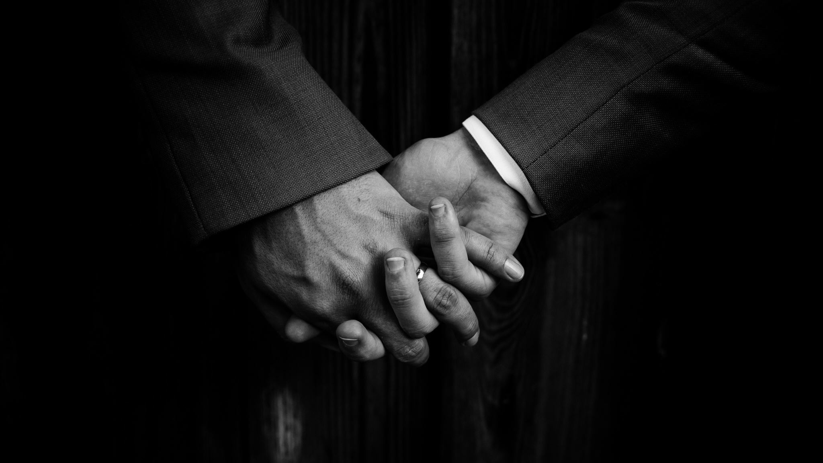
ANY QUETIONS

Slide 18

Thank you

